Slide 1
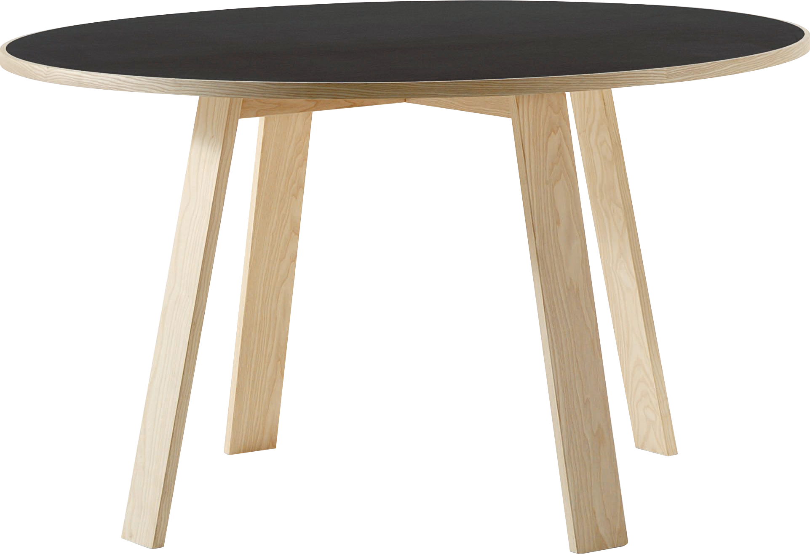
​
Welcome to Algebra 2
Mrs. Carter's Website
Delta Math

Slide 2
Weekly Overview
Lessons
13-3 Radian Measure
13-8 Trigonometric Functions
Activities
Bell Work
Notes
Real World Applications
Assignments
Complete & Submit Bell work
Complete & Submit Delta Math
Complete & Submit Enrichment
Complete Practice Problems

Slide 3
13-3 Radian Measure Standards Objectives
A2. F.TF.A.1 Understand and use radian measure of an angle. a. Understand radian measure of an angle as the length of the arc on the unit circle subtended by the angle. b. Use the unit circle to find sin θ, cos θ, and tan θ when θ is a commonly recognized angle between 0 and 2π. Commonly recognized angles include all multiples nπ /6 and nπ /4, where n is an integer.
A2. F.TF.A.2 Explain how the unit circle in the coordinate plane enables the extension of trigonometric functions to all real numbers, interpreted as radian measures of angles traversed counterclockwise around the unit circle.
SWBAT use radian measure IOT find the length of an arc of a circle.

Slide 4
13-3 Radian Measure Objective
SWBAT use radian measure IOT find the length of an arc of a circle.
A portion of a circle
A unit used to measure angles.

Slide 5
13-3 Radian Measure
Key Concepts
Central Angle
_____________________________ - an angle with the vertex at the center of the circle.
_____________________________ - the portion of the circle with endpoints on the sides of the central angle and remaining points within the interior of the angle.
___________________________-the measure of a central angle that intercepts an arc.
Intercepted Arc
Radian

Slide 6
Lesson 13-3 Notes
Examples
(I do) Convert radians to degrees.
a. $\frac{3π}{4}$
b. $\frac{π}{2}$
c. $\frac{5π}{6}$
(I do) Convert degrees to radians. Express your answer in terms of π and as a decimal rounded to the nearest hundredth.
a. 27$°$
b. 225$°$
c. -150$°$

Slide 7
Lesson 13-3 Notes
Examples
(We do) What are the exact values of the following?
a. cos $\frac{π}{4}$
b. sin $−\frac{π}{4}$
c. cos $\frac{π}{2}$
d. sin $\frac{π}{3}$
e. cos $3π$
4. (They do) Calculate a coterminal angle for each of the following.
a. $\frac{9π}{4}$
b. $3π$

Slide 9
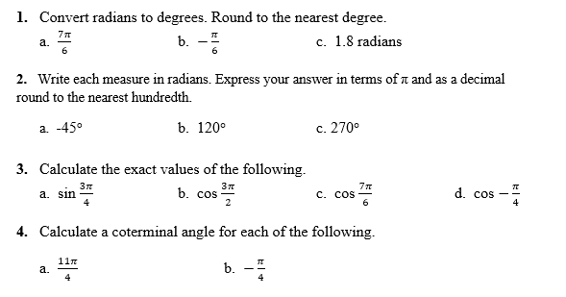
Independent Practice/Lesson Check 13-3

Slide 10
Independent Practice/Lesson Check 13-3

Slide 11
13-8 Trigonometric Functions Standards Objectives
A2. F.TF.A.1 Understand and use radian measure of an angle. a. Understand radian measure of an angle as the length of the arc on the unit circle subtended by the angle. b. Use the unit circle to find sin θ, cos θ, and tan θ when θ is a commonly recognized angle between 0 and 2π. Commonly recognized angles include all multiples nπ /6 and nπ /4, where n is an integer.
A2. F.TF.A.2 Explain how the unit circle in the coordinate plane enables the extension of trigonometric functions to all real numbers, interpreted as radian measures of angles traversed counterclockwise around the unit circle.
SWBAT graph trigonometric and reciprocal functions IOT evaluate them.

Slide 12
13-8 Trigonometric Functions Objective
sine, cosine and tangent
secant, cosecant, cotangent
SWBAT graph trigonometric and reciprocal functions IOT evaluate them.
Simply by finding an answer
A diagram that demonstrates the connection or relationship between quantities.

Slide 13
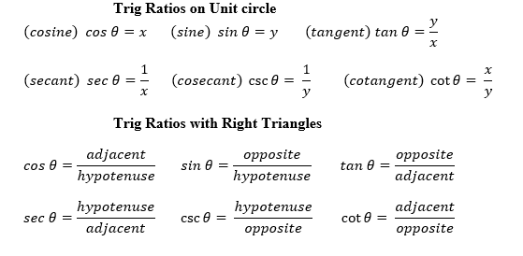
13-8 Trigonometric Functions
Key Concepts

Slide 14
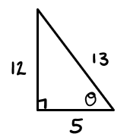
Lesson 13-8 Notes
Examples
1. (I do) Use the triangle to calculate the 6 trig functions

Slide 15
Lesson 13-8 Notes
Examples
2. (We do) Calculate the exact measures using the unit circle.
csc $\frac{π}{6}$ b. cot $\frac{−5π}{6}$ c. sec 3$π$
(They do) Calculate the value. Round to the nearest thousandth.
sec 2 b. cot 10 c. csc 35$°$ d. cot $\frac{π}{4}$
e. sin 150$°$ f. cos 50$°$ g. cot $\frac{π}{2}$

Slide 17
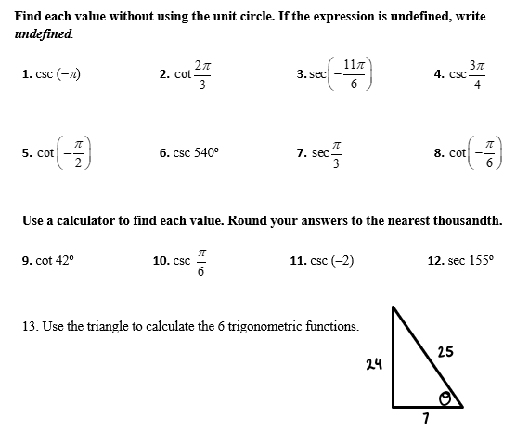
Independent Practice/Lesson Check 13-8

Slide 18
Independent Practice/Lesson Check 13-8

Slide 19
14-1 Trigonometric Identities Standards Objectives
A2.F.TF.B.3 Know and use trigonometric identities to find values of trig functions. a. Given a point on a circle centered at the origin, recognize and use the right triangle ratio definitions of sin θ, cos θ, and tan θ to evaluate the trigonometric functions. b. Given the quadrant of the angle, use the identity sin² θ + cos² θ = 1 to find sin θ given cos θ, or vice versa.
SWBAT, given the quadrant of θ, know and use the identity sin²θ +cos²θ=1 IOT find sin θ given cos θ, or vice versa.

Slide 20
14-1 Trigonometric Identities Objective
SWBAT, given the quadrant of θ, know and use the identity sin²θ +cos²θ=1 IOT find sin θ given cos θ, or vice versa.
property
One of 4 sections on the coordinate plane.

Slide 21
14-1 Trigonometric Functions
Key Concepts

Slide 22
Lesson 14-1 Notes
Examples
Verify the identity. a. $\sin{θ}(\sec{θ)=\tan{θ}}$ b. $\frac{\csc{θ}}{\sec{θ}}=\cot{θ}$

Slide 23
Lesson 14-1 Notes
Examples
2. Verify the identity.
a. $1+\tan^{2} θ= \sec^{2}θ$ b. $\tan^{2}θ−\sin^{2}θ=\tan^{2}θ\sin^{2}θ$

Slide 24
Independent Practice/Lesson Check 14-1

Slide 25
Independent Practice/Lesson Check 14-1

